Slide 1
“A Day in Your
Child’s Life
at Duncan Creek Elementary.”
Miss Wilbanks
Kindergarten

Slide 2
Miss Wilbanks
Kindergarten Class Schedule
2014- 2015
8:20 – 9:00 Arrival, Breakfast (optional), Morning Work Attendance & Morning Announcements
9:00 Restroom Break
9:15 – 10:30 Language Arts, Literacy Centers, Guided Reading & Writing
10:30 – 11:00 – Snack
11:00 – 12:00 – Math
12:00 – 12:15 - Restroom Break
12:15 – 12:45 – SPECIALS – Art, Music, Language Arts, & P.E.
12:50 – 1:15 - LUNCH (Table # 4 & #5)
1:15 – 1:30 - Restroom Break
1:30 – 2:00 – Outside Time, Playground
(We go out with Mrs. Corrigan’s K Class)
2:00 - Water, Restroom Break
2:15 – 3:00 – Science & Social Studies, Centers, Language Arts & Math Small Group Activities (Enrichment & Extra Help)
Complete Daily Behavior Calendar in red folders for all students
*Book Buddies with Mrs. Logan’s 1st Grade Class each Friday
3:00 – Clean-Up, Get ready to go home, Pass out daily folders, Storytime
3:30 – 3:45 – Dismissal, Bus Call

Slide 3
Conduct & Work Habits
Dear Parents,
If your child has a “good day” at school, I will indicate this with a “smiling face” or the day may be blank. I may not always have a chance to draw the “smiling faces” on the calendar, but feel free to do so each night at home with your child. :0) Please initial beside each day on your child’s calendar if he or she has a number marked. A number (or numbers) indicates an area where improvement is needed. Please use the number key to know how your child is doing each day. Please use the “zippered pouch” to send in notes or money. Also, your child may purchase ice cream each Friday for $ 1.00 (this is optional).
Thank You! Miss Wilbanks
#1 Shows self control
#2 Exhibits a positive behavior
#3 Controls talking
#4 Shows good manners
#5 Works and plays well in a group
#6 Respects others
#7 Actively participates in class
#8 Works independently /stays on task
#9 Returns materials sent home
#10 Listens and follows directions
#11 Completes assignments on time
#12 Uses time wisely

Slide 4



GCPS Writing Rubric for Narrative Writing
Kindergarten
 | Does Not Meet | Approaching Expectations | Meets Expectations | Exceeds Expectations
Ideas | I do not understand my story or picture. | I used a picture to tell my story. I attempted to write 1 or 2 sentences. | I wrote four or more sentences about my story. My picture and story match. | My story is interesting.
Organization | My words are in no order. | I wrote a beginning to my story. | I wrote a beginning and ending to my story. | I wrote a beginning, middle, and ending to my story. My sentences sounded smooth together.
Style | My words and pictures do not match. | I used easy or repeating words. I copied words from the teacher or classroom. | I used easy words and sentences. | I wrote many interesting words and sentences.
Conventions | My words are all over the page. | I have a lot of mistakes. My story is hard to understand. | I have some mistakes. I spell using sounds. I used some capital letters and endmarks. | The reader can understand my sentences. My words are spelled right. I used capital letters and endmarks.

Slide 5
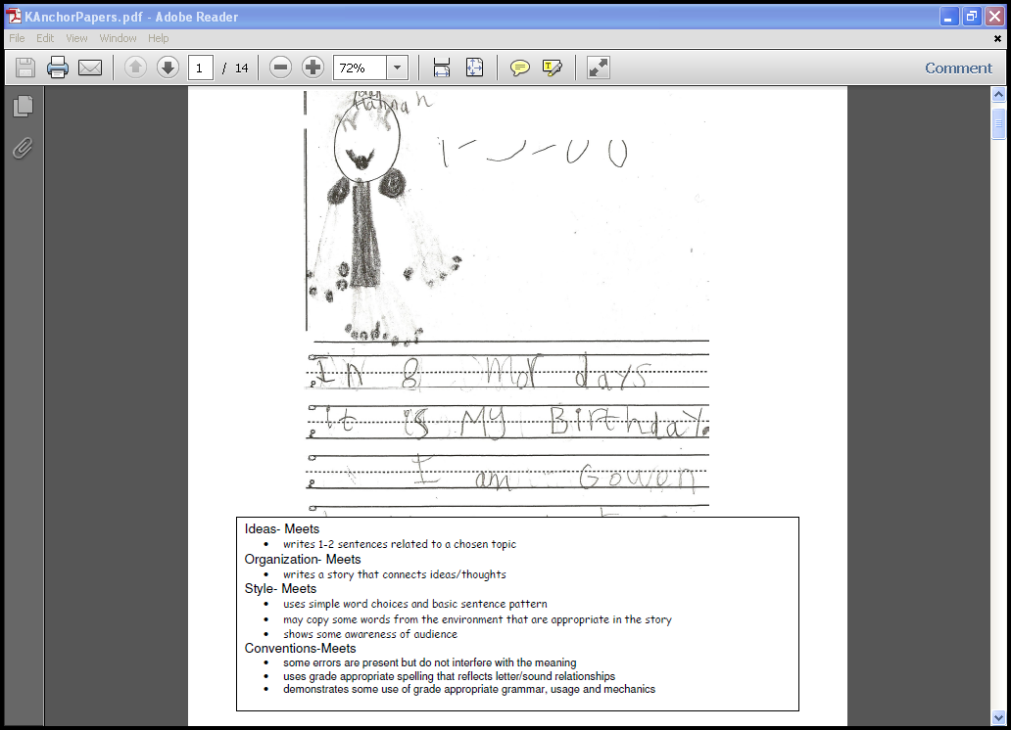

Slide 6
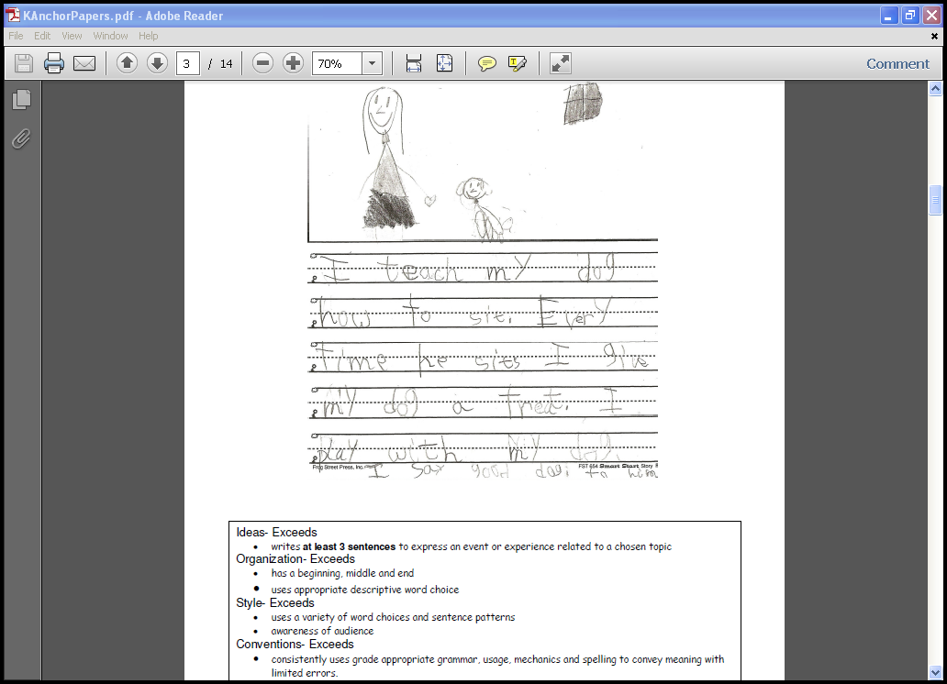

Slide 7
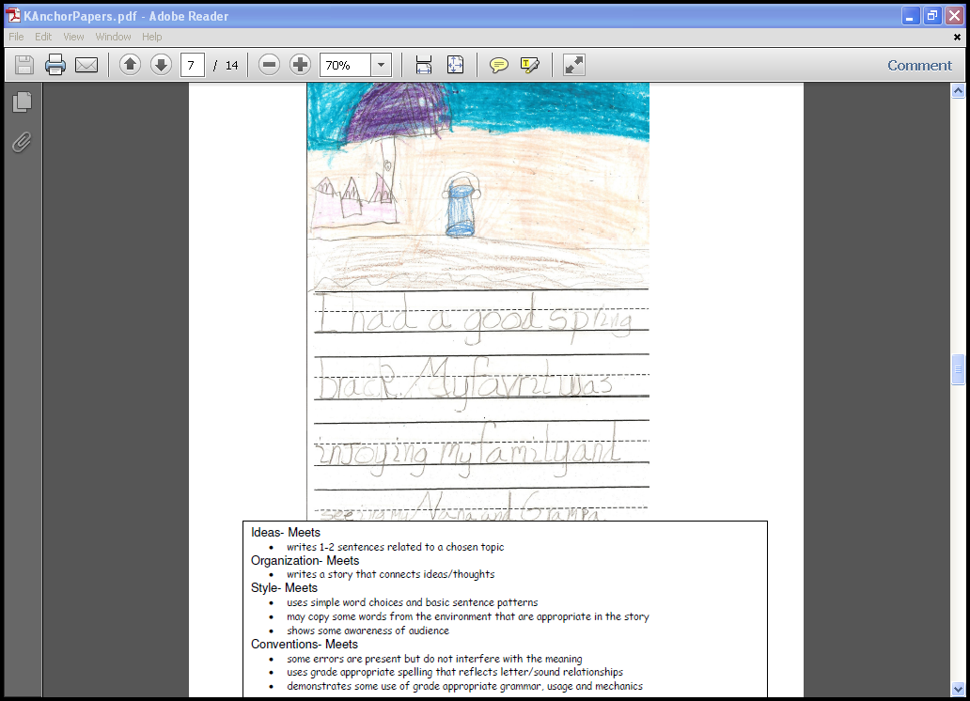

Slide 8
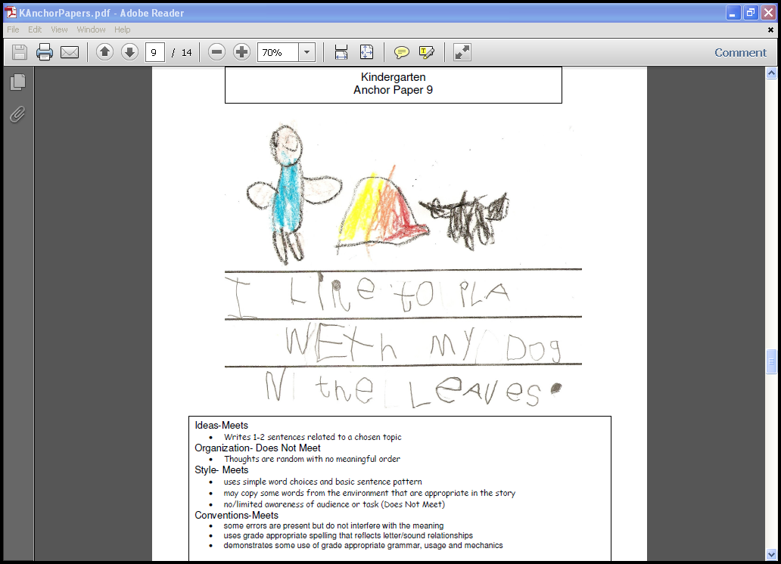

Slide 9
